Slide 1

Mentoring+Talent+Funding+Networks=Possible

Slide 2
PROBLEM STATEMENT
Effective Learning Managament Systems.
Needs a Gamified platform.
Effective individual Assessments.
Add to the Knowledgebase,ideas.
Automatic E-mail generation regarding progress.

Slide 3
What We Have Done??
Web Application-Managers
Android Application-Users
Common DataBase for both

Slide 4
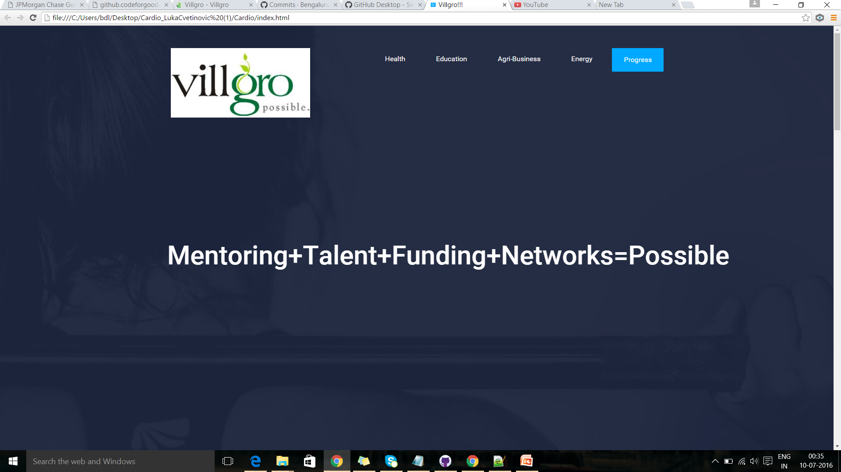
HOME PAGE

Slide 5
ENERGY

Slide 6
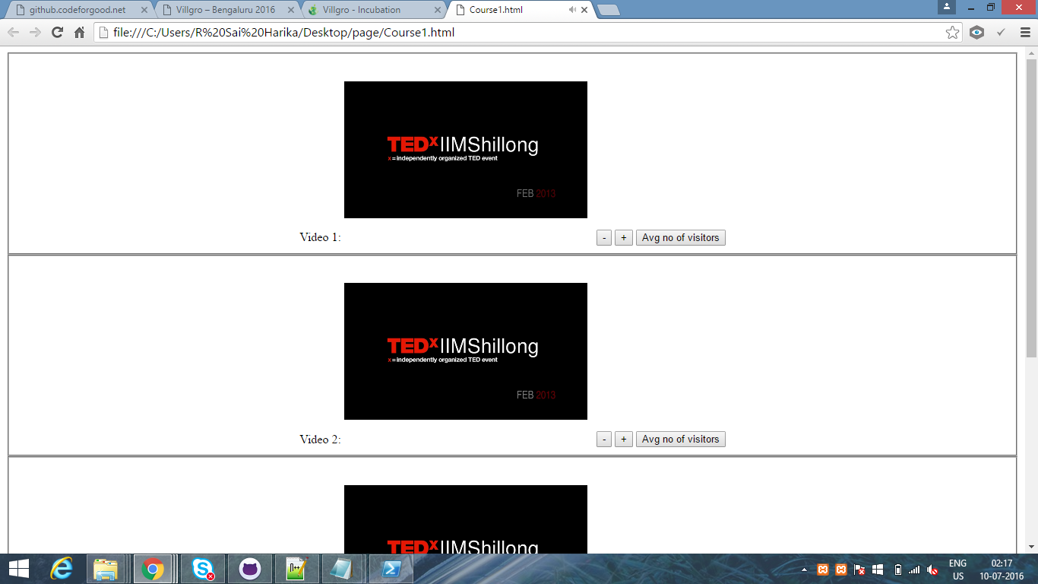
MANAGING TEAM

Slide 7
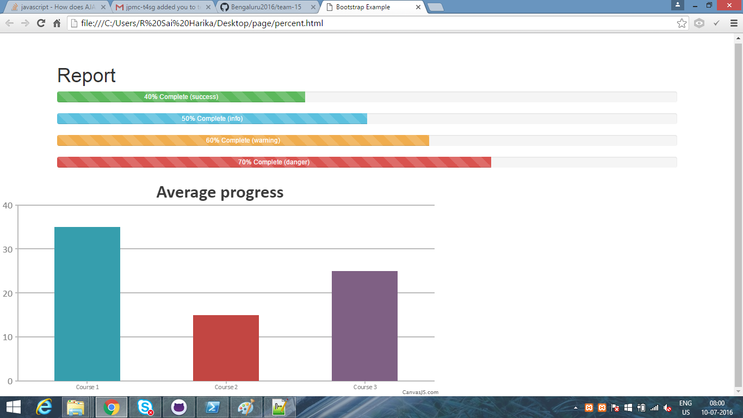
PROGRESS

Slide 8
Android Application
To choose the type of user-Mentor or Staff
Allows us to choose the name of the course.

Slide 9
Attempt the tests.
Assess yourself.

Slide 10
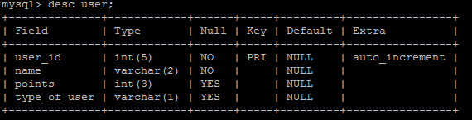
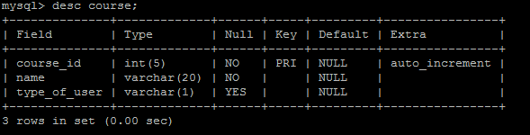
DATABASE

